Slide 1
Use Case Diagram
Rocket Launcher
Name & Registration No:
Md Sirazul Islam(16201059)
Md Ansaruzzaman(16201152)

Slide 2
Actors
User
Nasa Open API (Launch)
Nasa Open API (Mission)
Nasa Open API( Hubble Website)
Nasa Open API ( Live Youtube)
Nasa Open API ( Rocket Image)

Slide 3
Use-Case
Launch Schedule
Next Launch Time
Details Activity
Mission
Updated Mission
Mission Details Activity
News Archive
Updated News
Gallery
Image of Rocket
Nasa Live
Nasa YouTube live TV
Nasa Space Education
Nasa Website

Slide 4
Use-Case & Their Actor
Use Case | Actor
Launch Schedule | User
Next Launch Time | User, Nasa Open API
Details Activity | User, Nasa Open API
Mission | User
Updated Mission | User, Nasa Open API
Mission Details Activity | User, Nasa Open API
News Archive | User
Updated News | User, Nasa Open API
Gallery | User
Image of Rocket | User, Nasa Open API
Nasa Live | User
Nasa YouTube live TV | User, Nasa Open API
Nasa Space Education | User
Nasa Website | User, Nasa Open API

Slide 5
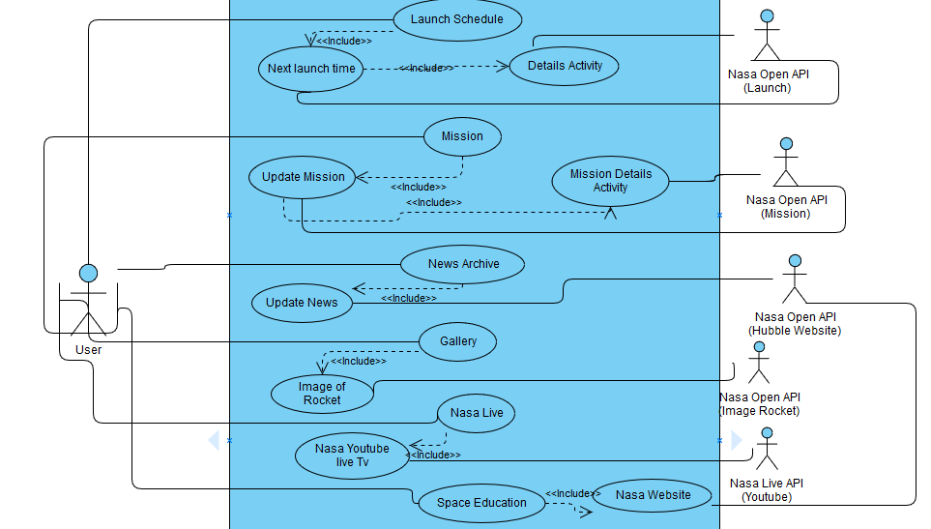
Use Case Diagram

Slide 6
Thank You

